Slide 1
PUNE 2022

Slide 2

Scan QR code to participate in Quiz

Slide 3

Q1. Who do you see in above image ?

Slide 4
Simplifying K8S setup on AWS using KOPS
Sagar Utekar | December 10, 2022

Slide 5
About Me
Working as Site Reliability Engineer at VMWare Software India PVT. LTD.
Open-Source Enthusiast, A firm believer in the power of community education.
Google Summer Of Code Admin, Mentor, Mentee 2022 @PEcAn Project
CKS | CKA | CKAD | Terraform Certified
Mentored 5000+ students & professionals across India for career guidance, Job Search, Open Source, Cloud Native

Slide 6
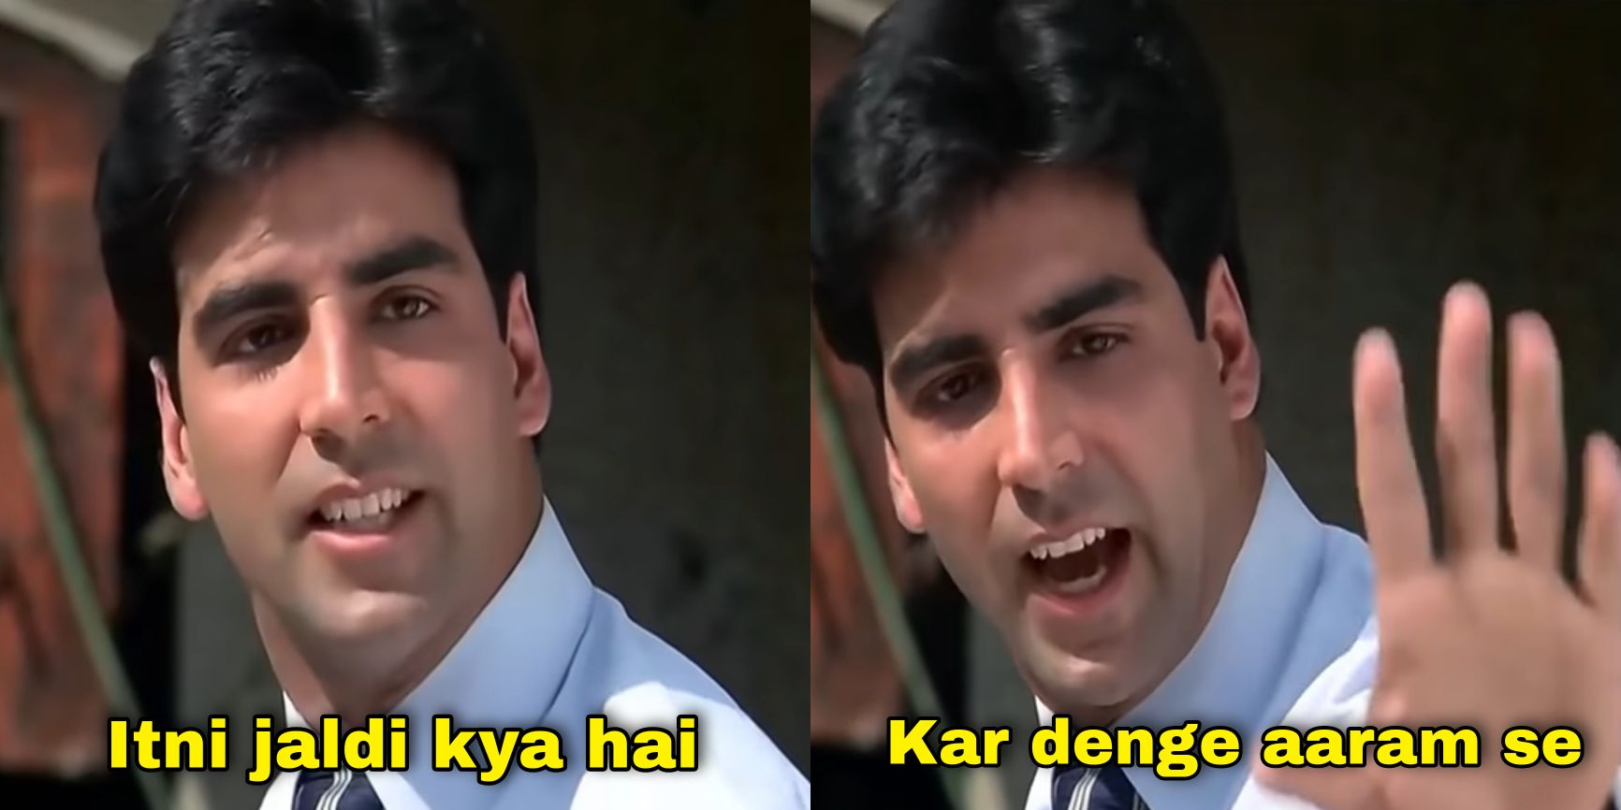

Slide 7
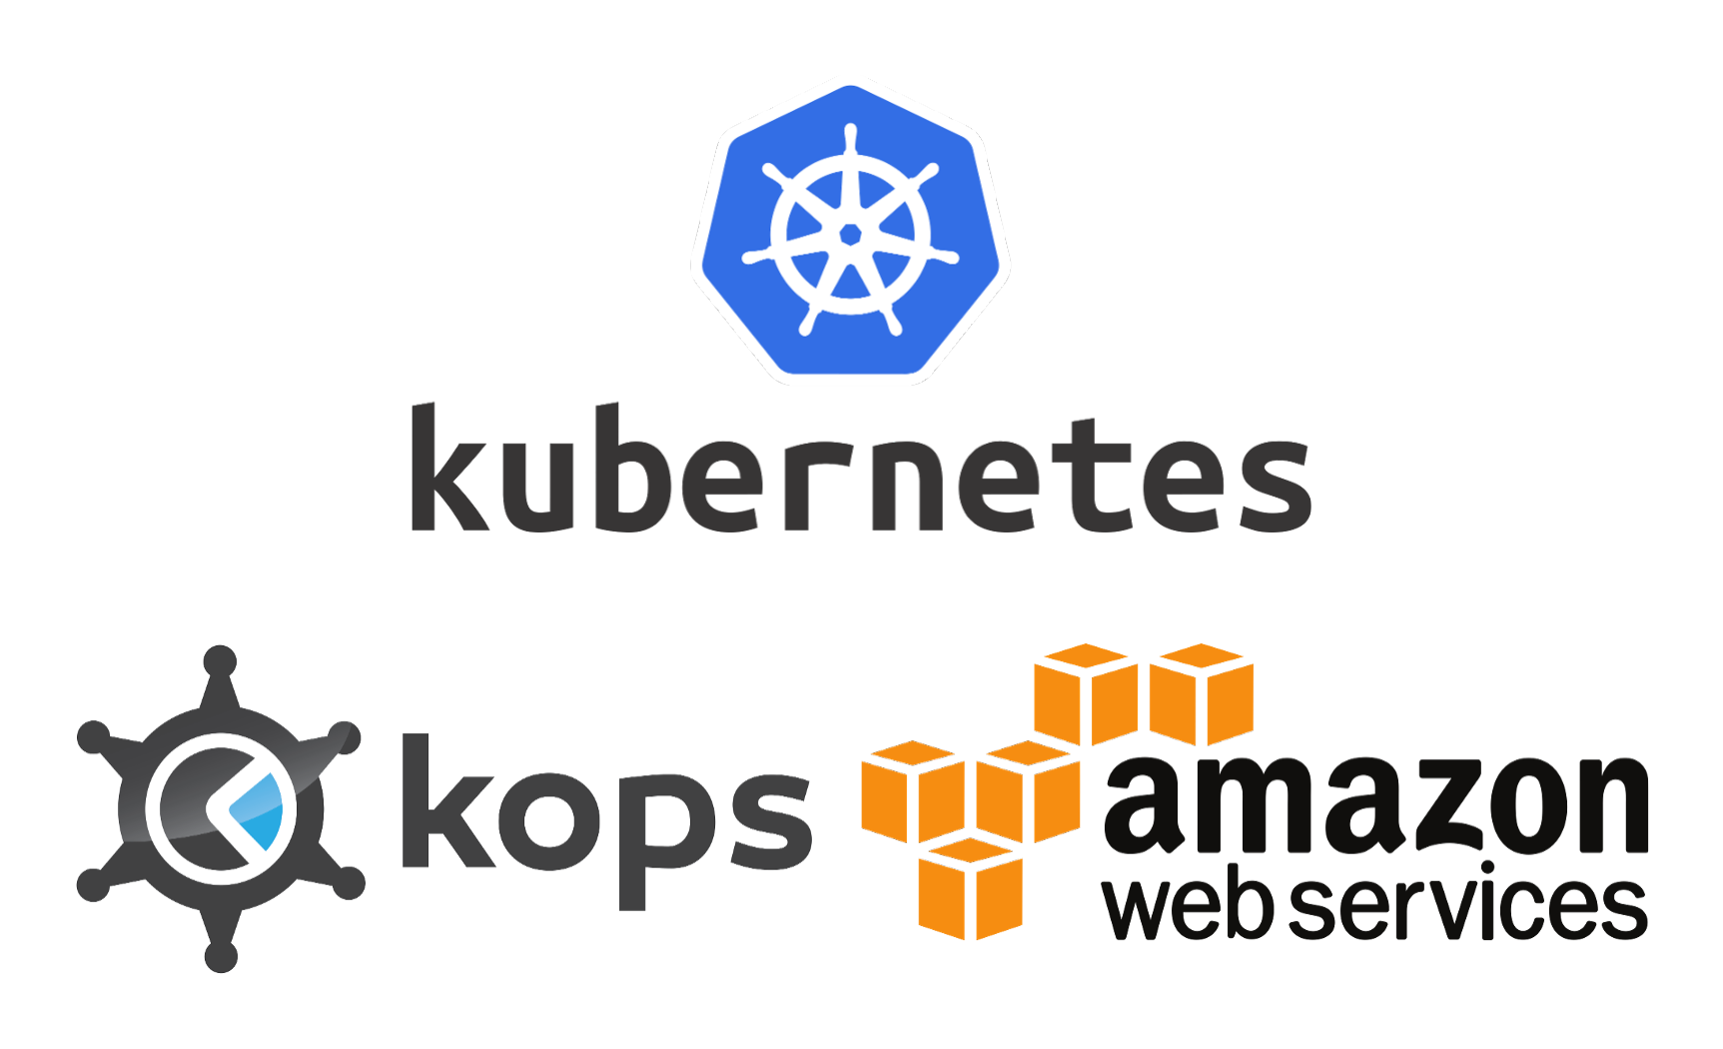
Q2. Have you heard about Kubernetes & KOPS ?
YES
NO

Slide 8
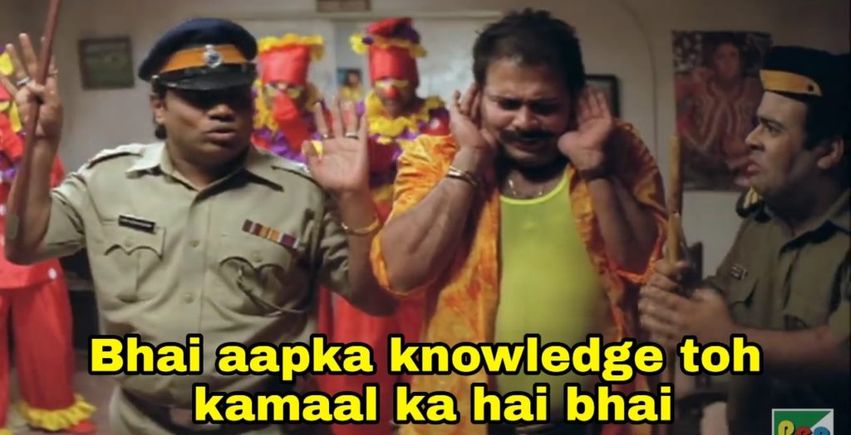

Slide 9
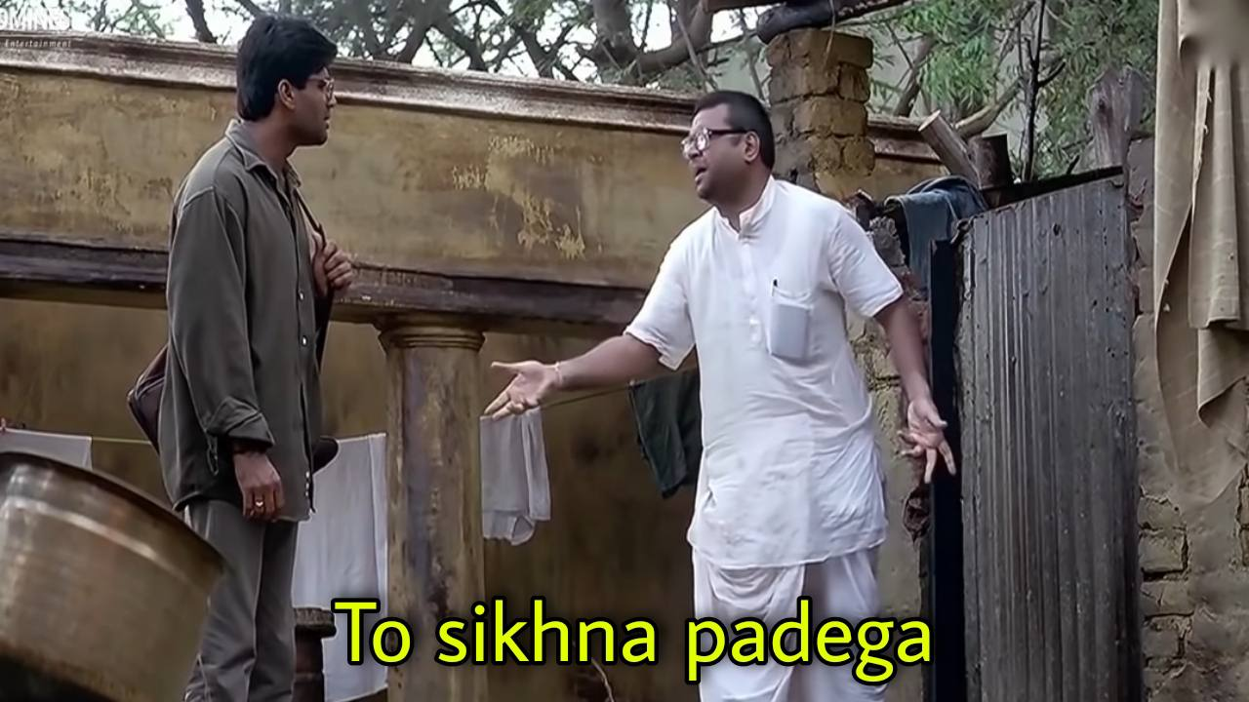

Slide 10
Agenda
Overview of Kubernetes & KOPS
KOPS K8S cluster Architecture
Activities needed to get production ready k8s in AWS
Deciding best solution for your use case

Slide 11
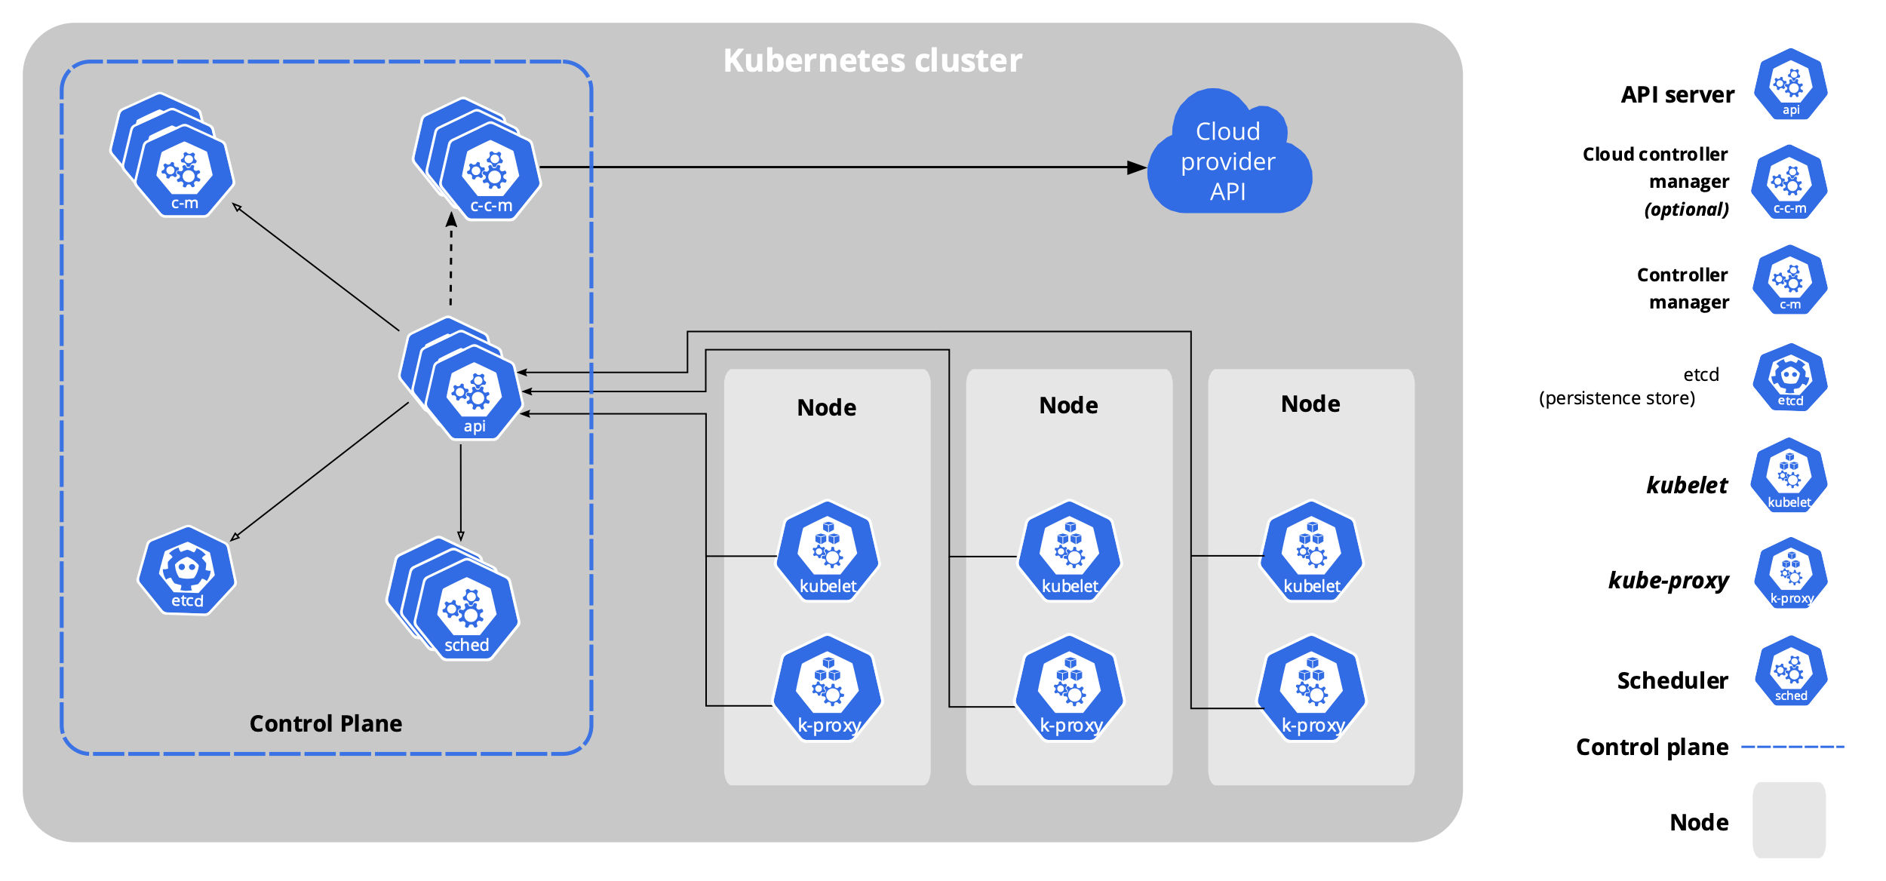
Overview of Kubernetes
Kubernetes is an open source, container orchestration platform. Applications packaged as Docker images can be easily deployed, scaled, and managed in a Kubernetes cluster.

Slide 12
Overview of KOPS
Kops, short for Kubernetes Operations, is a set of tools for installing, operating, and deleting Kubernetes clusters in the cloud. A rolling upgrade of an older version of Kubernetes to a new version can also be performed.
Features -
Automates the provisioning of HA K8S clusters
Built on a state-sync model for dry-runs and automatic idempotency
Supports zero-config managed Kubernetes add-ons
Templating and dry-run modes for creating Manifests
Choose from most popular CNI Networking providers out-of-the-box
Multi-architecture ready with ARM64 support

Slide 13
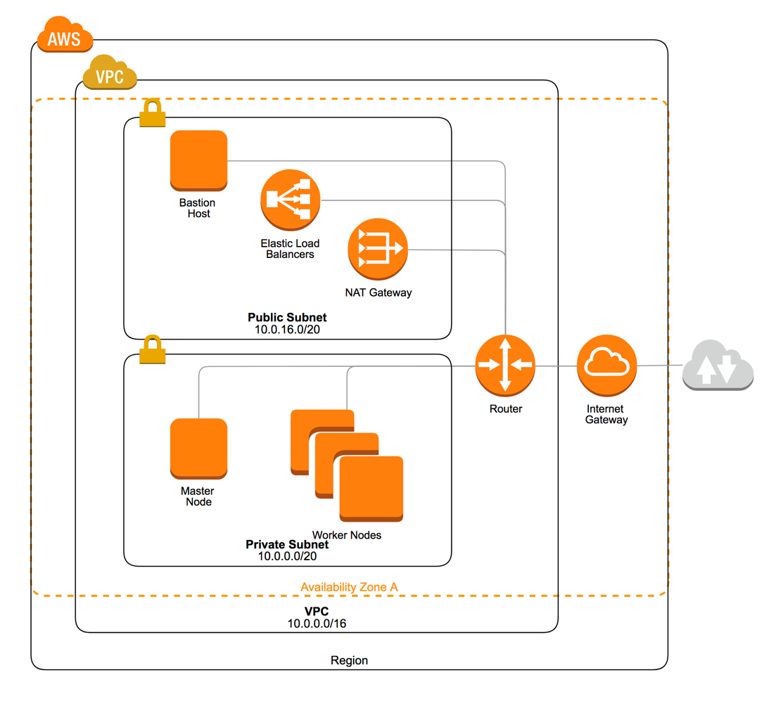
KOPS K8S Cluster Architecture

Slide 14
Q2. Should we start creating cluster in AWS using KOPS ?
YES
NO

Slide 15
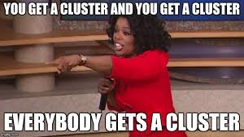

Slide 16
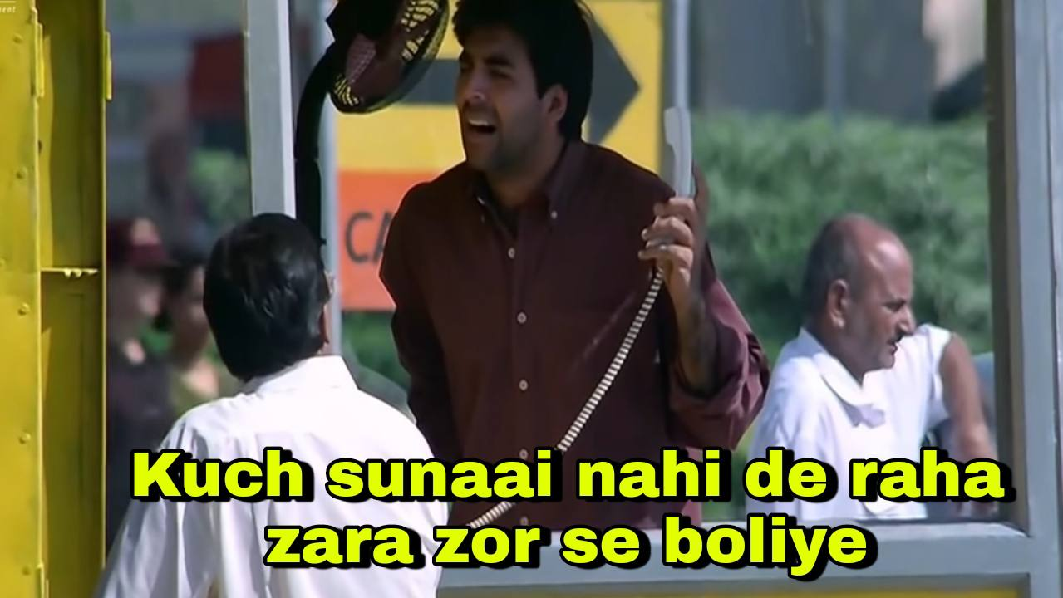

Slide 17
Activities needed to get a production ready K8S in AWS
Setup k8s Cluster in AWS using KOPS
SSH access to clusters
Upgrading clusters
Addons
Monitoring for K8S cluster
RBAC Setup
Audit Logging
Infrastructure and cost alerts
Troubleshooting
https://github.com/Sagar2366/tech-talks.git

Slide 18
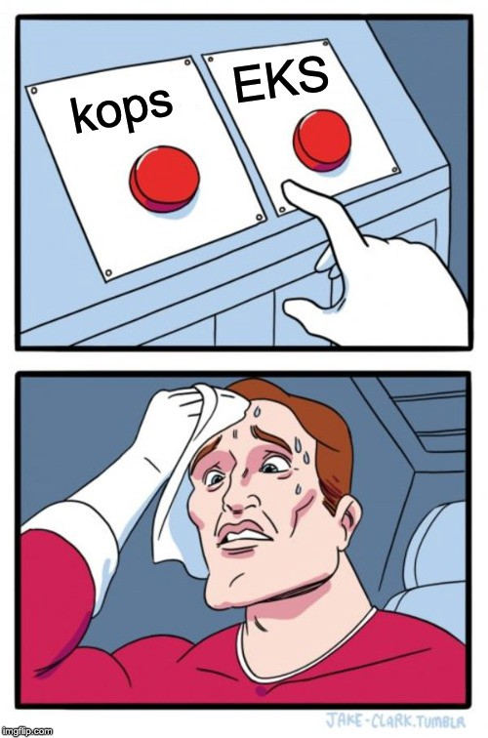
Decide what’s best for your use case

Slide 19
What’s included for setup
Area | KOPS | EKS
Etcd | Included (Master) | Included
Networking | NA | AWS Support
DNS | Partially (Requires third party domain) | Included
Monitoring | NA | Included
Logging | NA | Included
Storage | NA | Included
Load Balancing | Included | Included

Slide 20
Who’s responsible when it breaks ?
Area | KOPS | EKS
Control plane | Community Support | EKS
Networking | “” | AWS Support
Cert manager | ”” | Community Support
Monitoring | ”” | AWS Support
Logging | “” | “”
Storage | “” | “”
Load Balancing | “” | “”

Slide 21

Questions & Answers

Slide 22
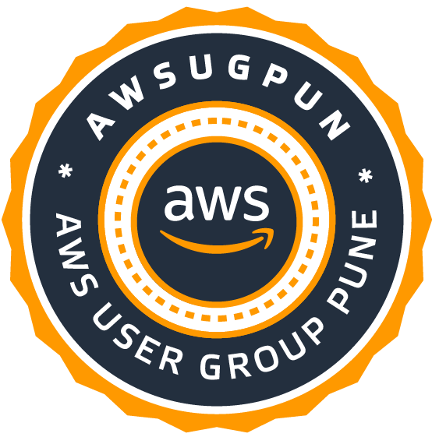
Thank you!
See you at the AWS Community Day Pune 2023

Slide 23

Connect with me
https://www.linkedin.com/in/sagar-utekar/
https://twitter.com/me_sagar_utekar
https://github.com/Sagar2366

